Slide 1
Elements and Principles of Art and Design
(according to the College Board)

Slide 2
The Elements
line
shape
color
value
texture
space

Slide 3
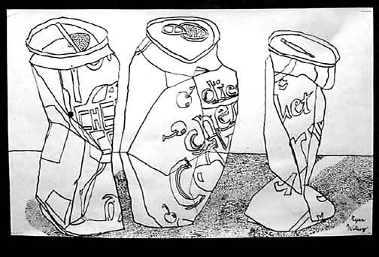
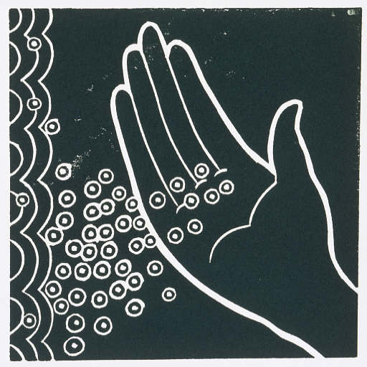
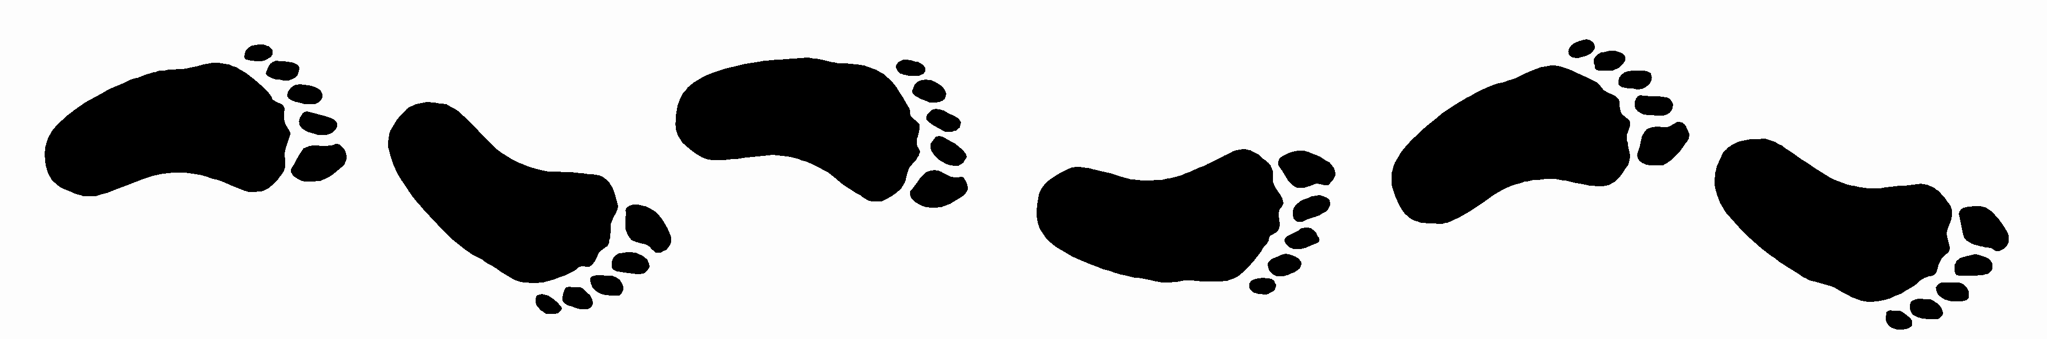
Line – the path between two points. Also, a mark on a surface that describes a shape or outline. It can create texture and can be thick and thin. Types of line can include actual, implied, vertical, horizontal, diagonal and contour.
Contour Line
Outline
Implied Line

Slide 4
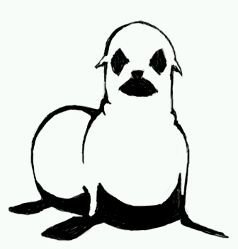
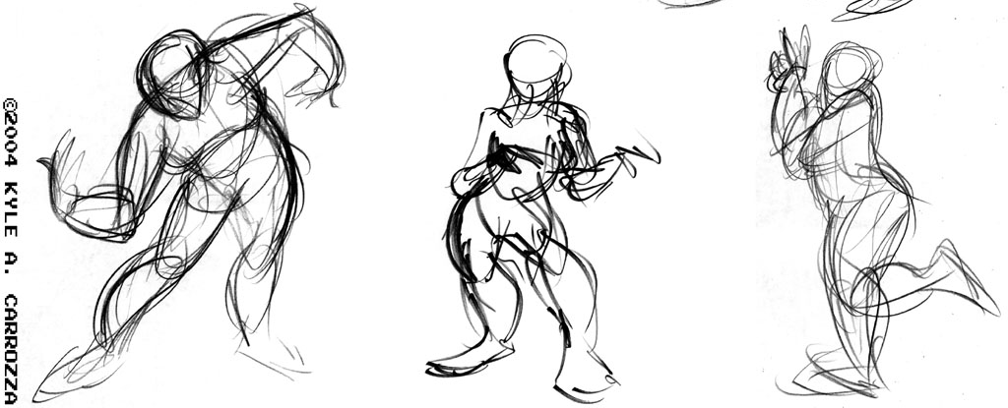
More on Line
Varying the thickness or thinness of a line can add interest and give a sense of 3-Dimensionality. Here, the thick lines of this drawing represent the shadows or darker areas of the seal.
Using line loosely and quickly can help convey motion or movement. Below are some examples of gesture drawings.

Slide 5
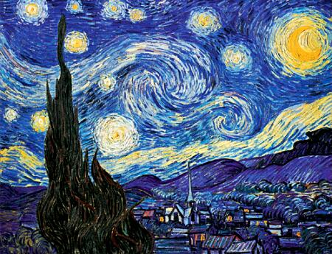
How some artists use line…
Vincent Van Gogh
“Starry Night”

Slide 6
Shape
2-dimensional area defined by a line. Shapes are flat and can be grouped into two categories, geometric and organic (free form).
Geometric shapes can be defined by a mathematical formula. ( L x W = Area )
Organic or freeform shapes have no particular formula to how they are created.

Slide 7
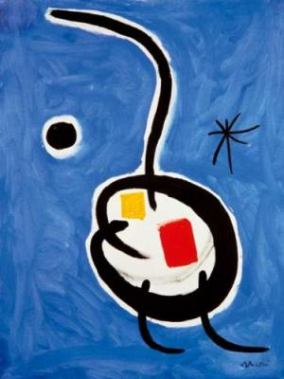
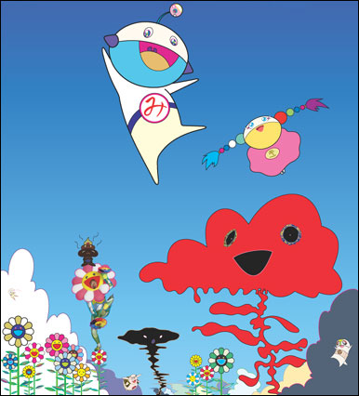
Joan Miro “Personage Etoile”
Takashi Murakami
Which is more important - line or shape?

Slide 8
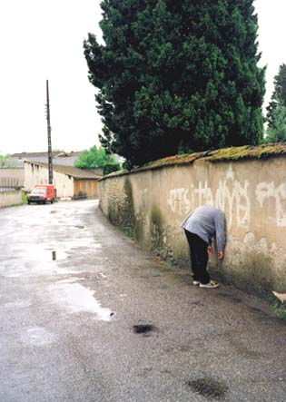
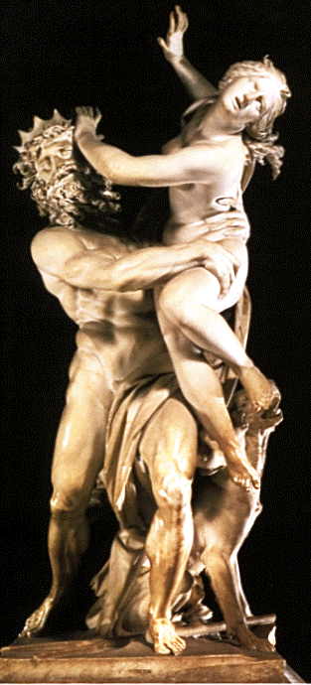
Form
(element) A form is a three dimensional object, or an image that has the illusion of being three-dimensional.
Benini
“Pluto and Persephone”
These are pictures actual sculptures, or three-dimensional forms
Erwin Wurm

Slide 9
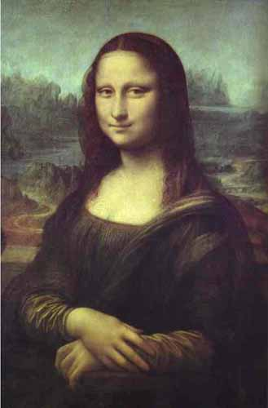
A painting of a person that looks 3-Dimensional (uses Form)
Leonardo Da Vinci
“Mona Lisa”

Slide 10
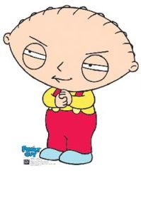
Versus a painting of a person that looks flat (uses shape)
Stewie

Slide 11
Color
has three properties:
hue (name), value (light dark), and intensity (chroma, dull/intense).
What colors do you see?
Are the colors light or dark?
Are the colors bright or dull?
Why do you think those colors were used?

Slide 12
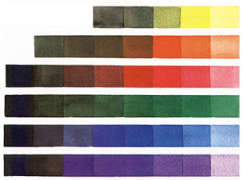
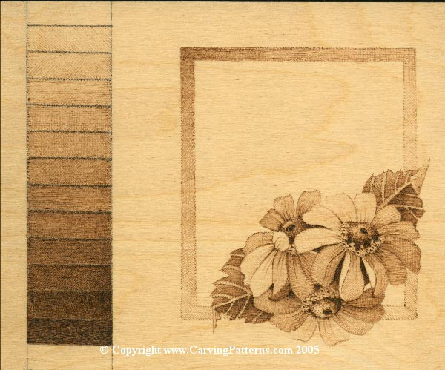

Value
(element) refers to the degree of light and dark. It is the contrast between black and white and all the tones in between. Value can be applied to color as well as black and white. Contrast refers to the difference between to or more values.
Examples of different value scales

Slide 13
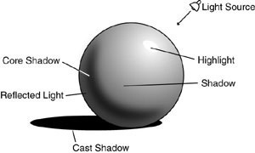
An example of how value gives form to flat shapes:
To make a flat shape look three dimensional, we add value. Specifically, we add shadows, highlights, and midtones.

Slide 14
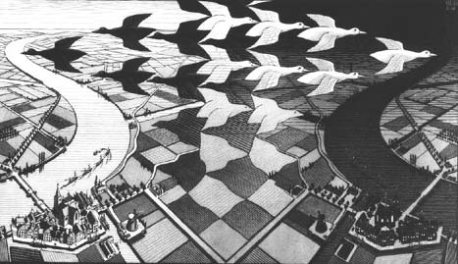
In this M.C. Escher drawing, value is used in a number of ways. The artist uses value to give a sense of 3-Dimensionality to the cities at the bottom of the drawing. How does he use value symbolically?

Slide 15
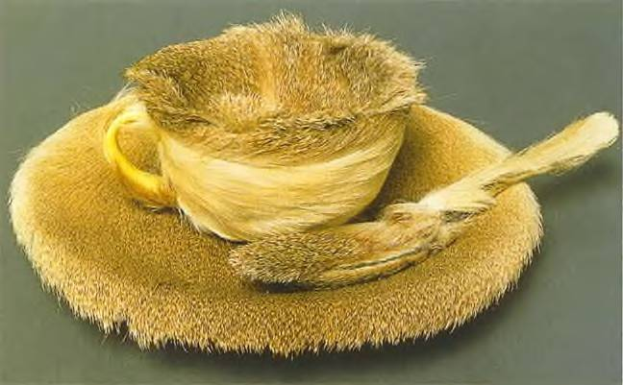
Texture - is about surface quality, either tactile (the way it feels) or visual (the way it looks). Texture can be real or implied by different uses of media. It is the degree of roughness or smoothness in objects.
How does artist Meret Oppenheim use texture in this work of art?
What do you think she was trying to make the viewer feel by covering a teacup in fur?

Slide 16
The Principles
unity/variety
balance
emphasis
contrast
rhythm
repetition
proportion/scale
figure/ground relationships

Slide 17
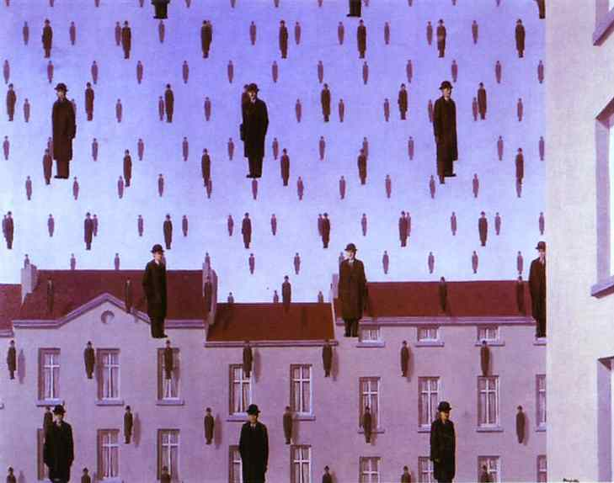
You can put peanut butter and mayonnaise on the same sandwich, but it doesn’t mean it will taste good. Unity is the feeling of harmony between all parts of the artwork creating a sense of completeness. Variety, having difference between elements, gives a composition interest.
Unity/Variety
Repeating elements in a design helps a composition feel unified.
What elements are repeated?
Does this piece feel unified to you?

Slide 18
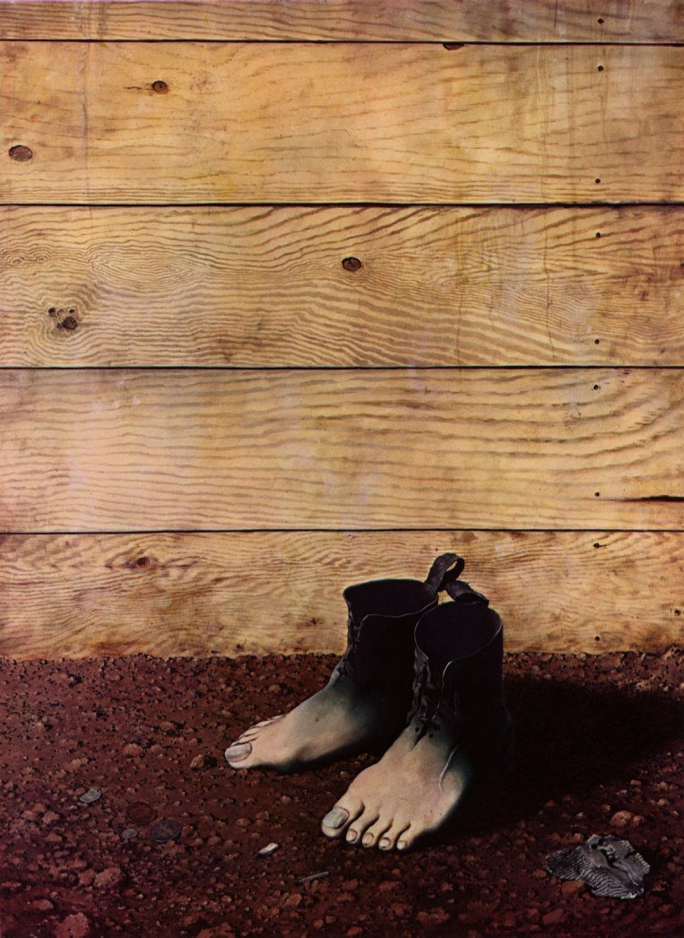
Balance - is a feeling of visual equality in shape, form, value, color, etc.
Balance can be symmetrical or evenly balanced or asymmetrical and un-evenly balanced.
Objects, values, colors, textures, shapes, forms, etc., can be used in creating a balance in a composition.
What kind of balance does Rene Magritte use in this artwork?
What effect does it have on the artwork?

Slide 19
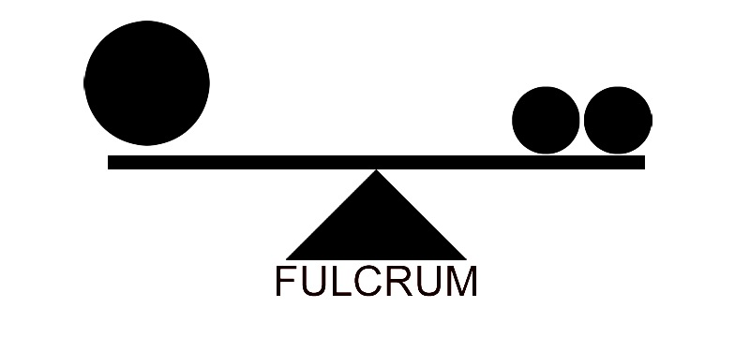
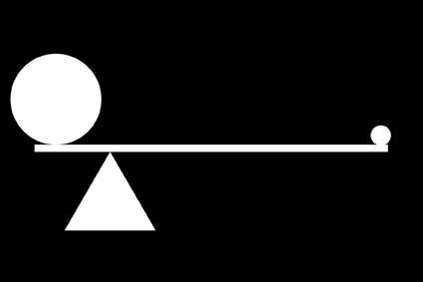
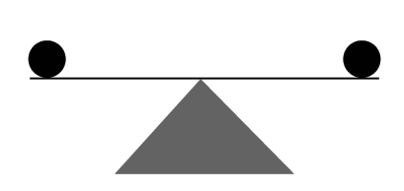
Visual Weight & Balance
Asymmetrical
Symmetrical

Slide 20
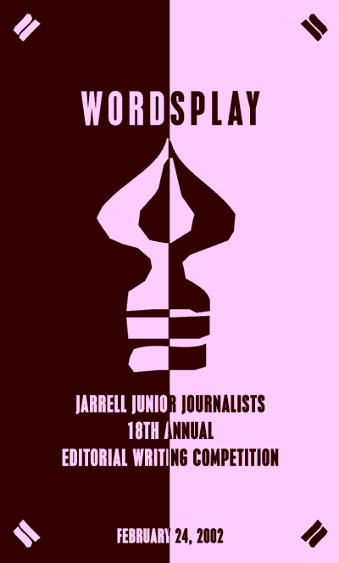
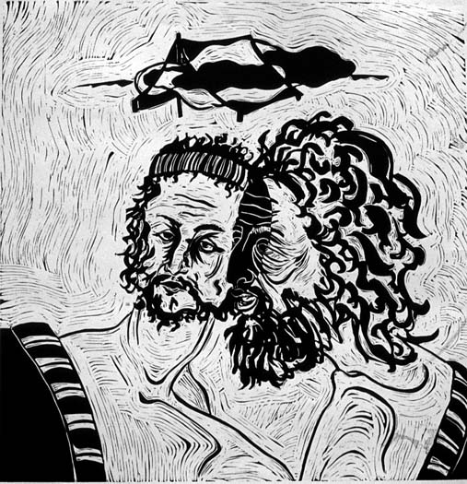
Symmetrical and Asymmetrical Balance
Symmetrical balance is easiest to see in perfectly centered compositions or those with mirror images.

Slide 21
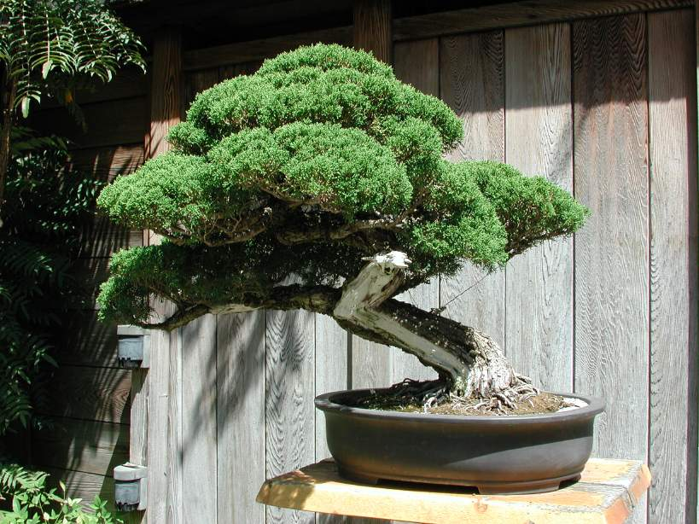
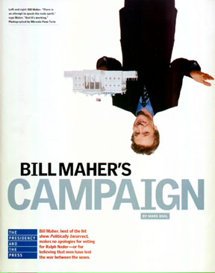
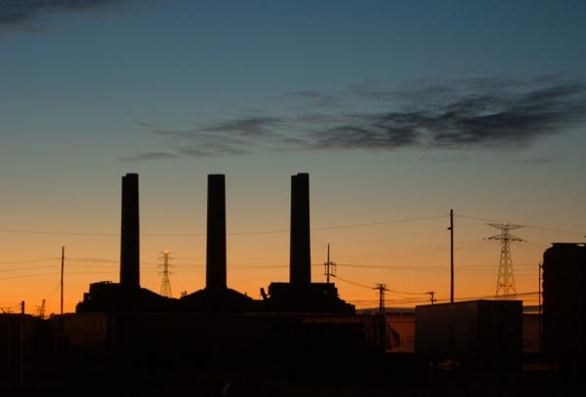
Asymmetrical Balance
Asymmetrical balanced designs are typically off-center or created with an odd or mismatched number of disparate (different) elements.
Asymmetrical designs still have balance. Think of it like standing on one foot- you wont fall because you shift your weight in order to balance and remain standing.

Slide 22
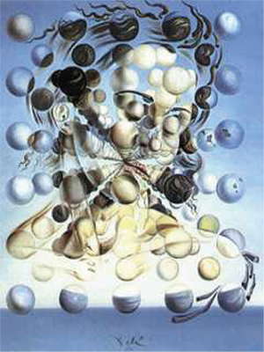
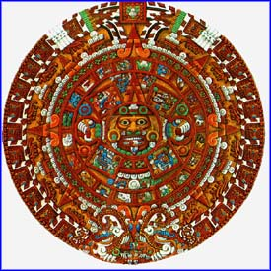
Balance
Examples of radial balance (elements move outwards from a point equally in all directions).
Mayan Calendar
Salvadore Dali

Slide 23
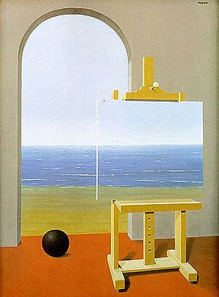
Emphasis – Artists use emphasis to make parts of a composition stand out and grab your attention. This area is more important when compared to the other objects or elements in a composition. This can be by contrast of values, more colors, and placement in the format.
This is another painting by Rene Magritte.
Where is the emphasis (focal point) of this painting?
Is the focal point an important part of this painting?
Why would Magritte make this area the focal point?

Slide 24
Contrast is the degree of difference between two elements, or juxtaposition of opposing elements.
Contrast in value:
An example of low contrast
An example of high contrast
Contrast in color:
An example of low contrast between two colors
An example of high contrast between two colors

Slide 25
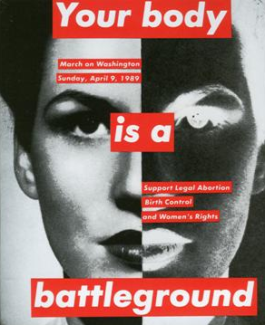
Barbara Kruger “Your Body is a Battleground”
Look at this work by Barbara Kruger.
How does artist Barbara Krueger use contrast in this artwork?
Why do you think she uses such strong contrast? What is she trying to say?
How does she use the principle of contrast to support her message?

Slide 26
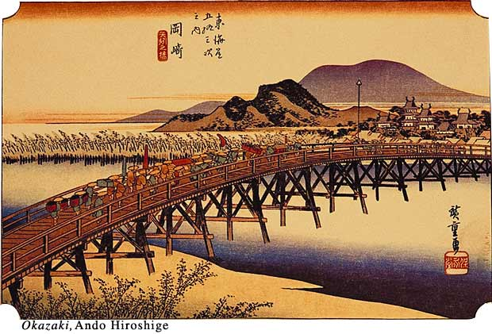
Rhythm – (principle) is a movement in which some elements recurs regularly. Like a dance, it will have a flow of objects that will seem to be like the beat of music.
The repeating lines of the bridge supports and the reoccurring colors of the people on the bridge create rhythm. What are the people doing? Why did the artist make rhythm an important principle in this painting?

Slide 27
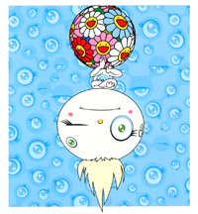
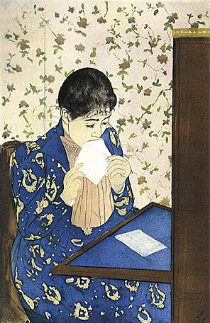
Repetition – elements are repeated in a composition
Where does artist Mary Cassat use repetition in this artwork?
Where does artist Takashi Murakami use repetition in this artwork?

Slide 28
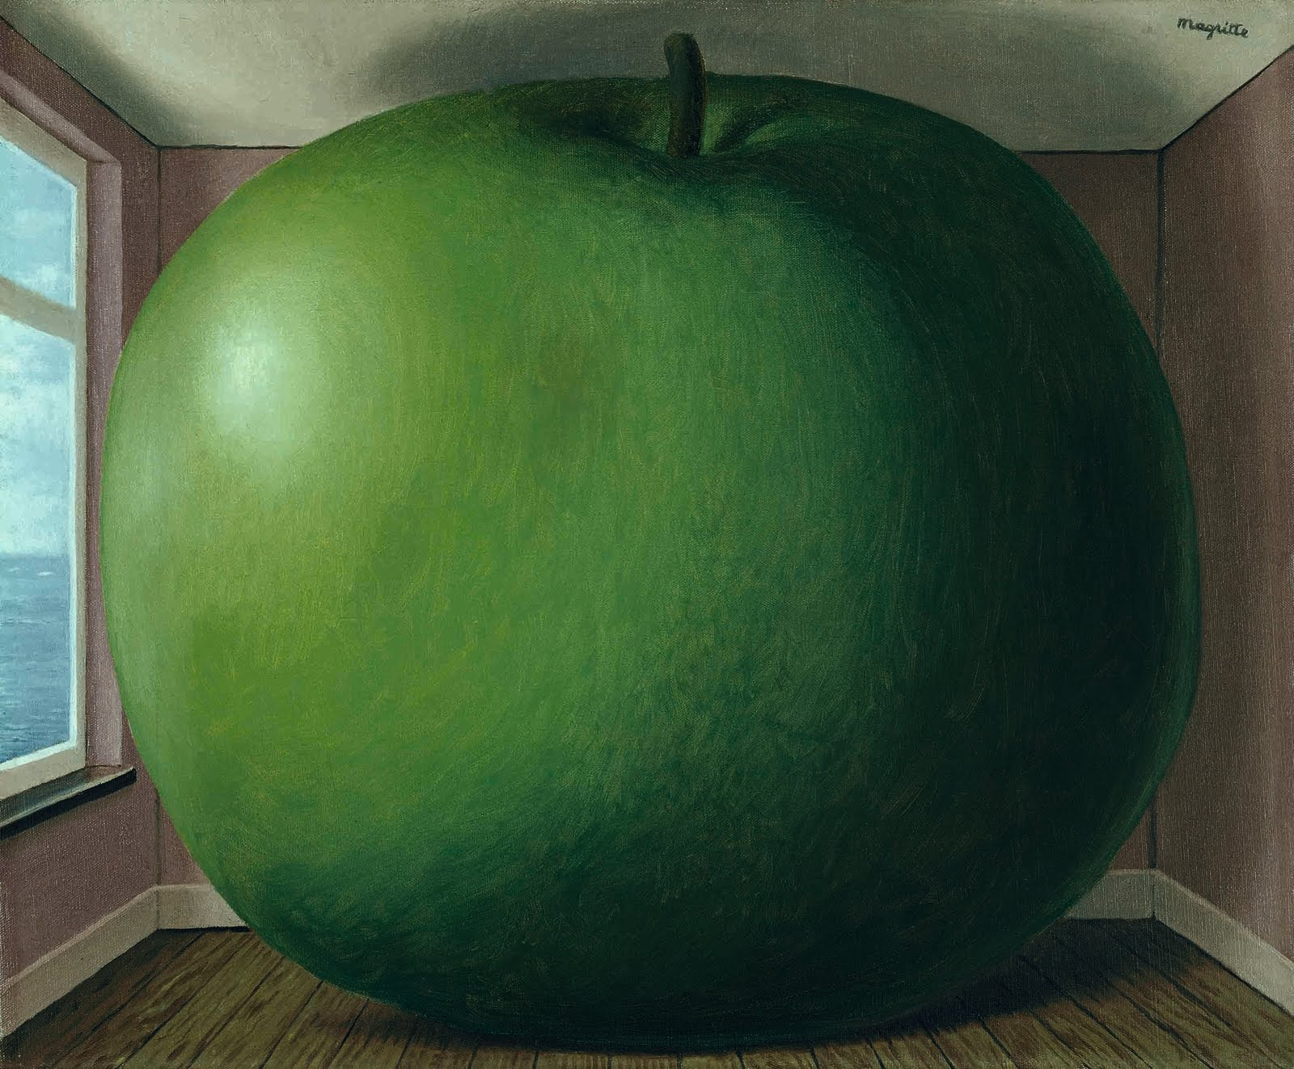
Proportion/Scale
- relative size. The size of one element compared to another.
Is the apple really large, or is the room really small?

Slide 29
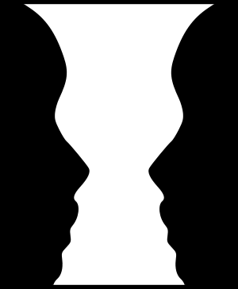
Figure-Ground
Figure–ground relations are a type of perceptual grouping which is a vital necessity for recognizing objects through vision.
It is how the object relates to the background, or the relationship between foreground and background.
      For example:
      Is it a vase, or two faces?

Slide 30
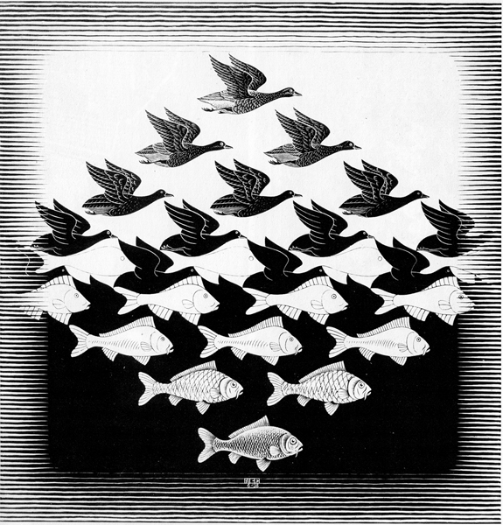
What do you see in the foreground?
What color is the background?

Slide 31
What do you see in the foreground?
What color is the background?

Slide 32
This is an artwork by M.C. Escher.
What do you see in the foreground?
What color is the background?

