Slide 1
Artist Trading Cards

Slide 2
You are creating a series of 9 artworks.
Series-
“Common thread”
Similar subject matter, theme, topic, etc.
Also-- similar colors, patterns, styles, motifs,etc

Slide 3
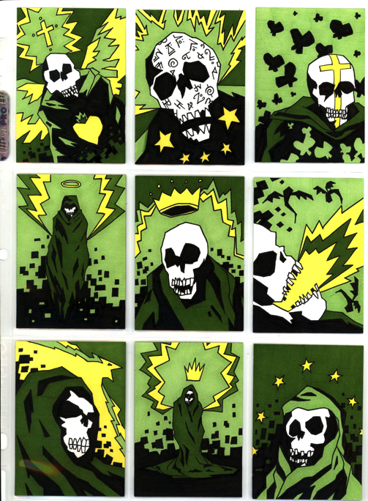
Notes:
How can you tell these are all from the same series

Slide 4
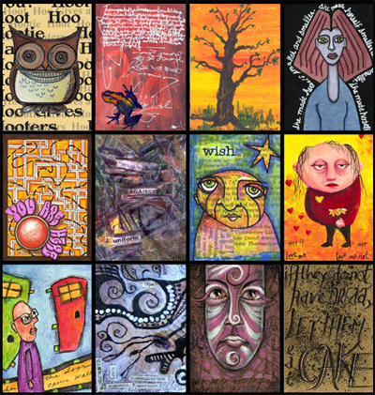
Notes:
Is this a series? No. I put this in because there are cool techniques in here.

Slide 5
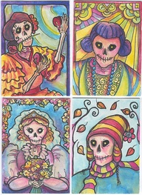
Notes:
Is this a series? I would say yes… theme is ?? But they’re all skeletons, and the style is very similar.

Slide 6
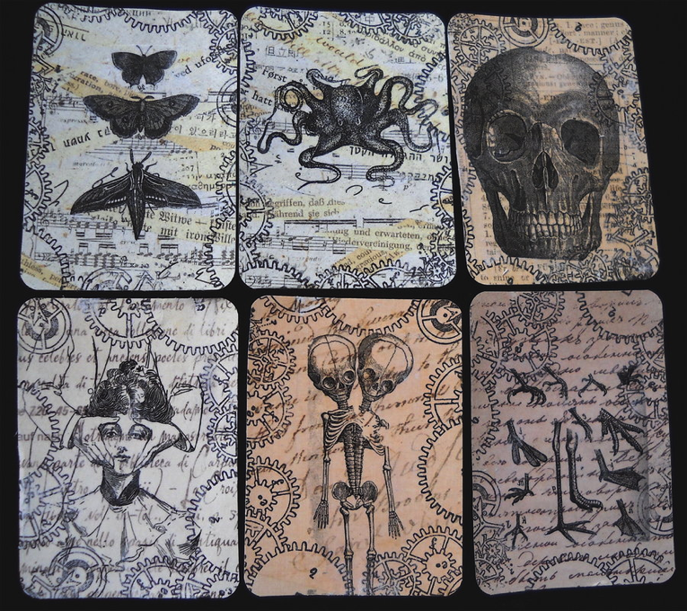
Notes:
What are the similar motifs tou

Slide 7
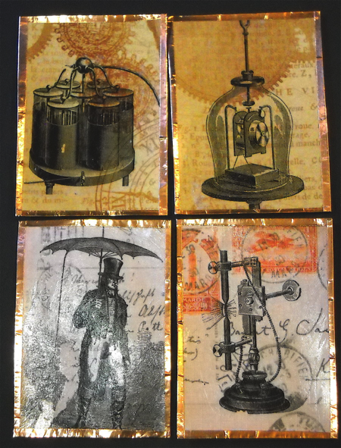
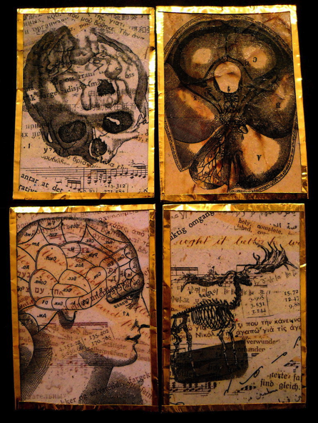

Slide 8
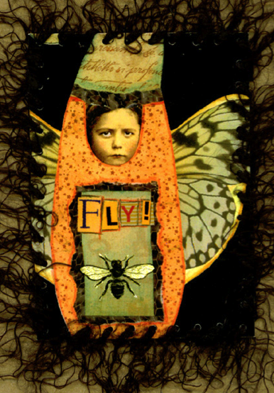
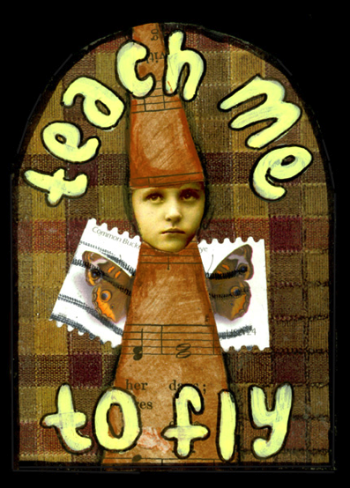

Slide 9
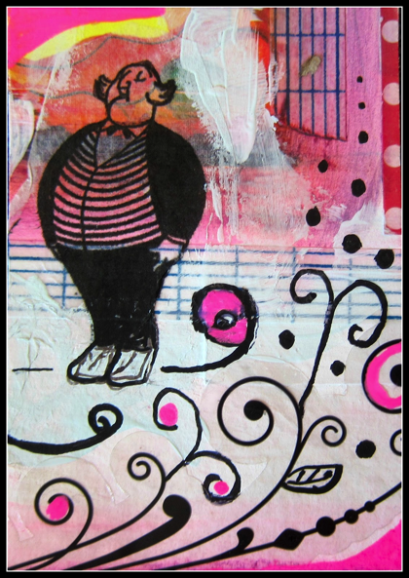

Slide 10
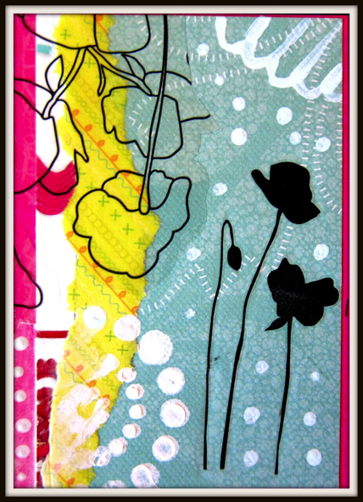
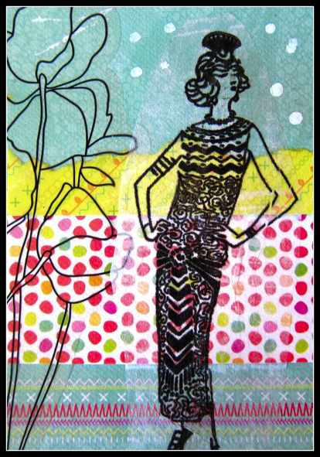

Slide 11
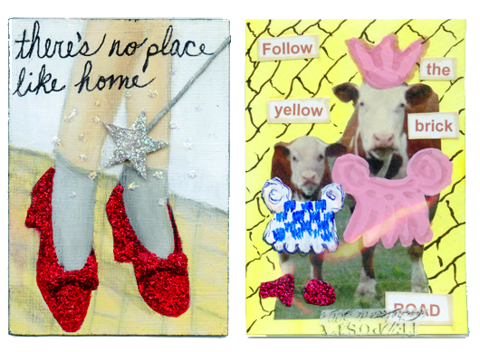

Slide 12
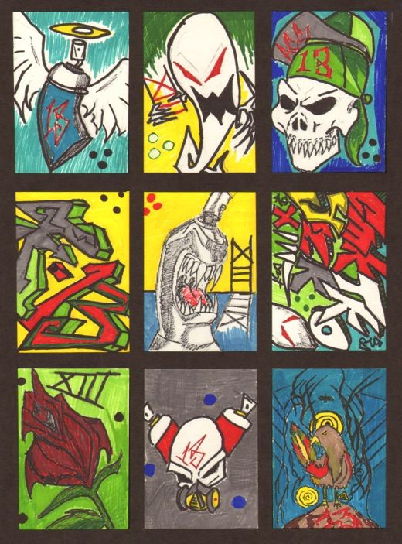

Slide 13
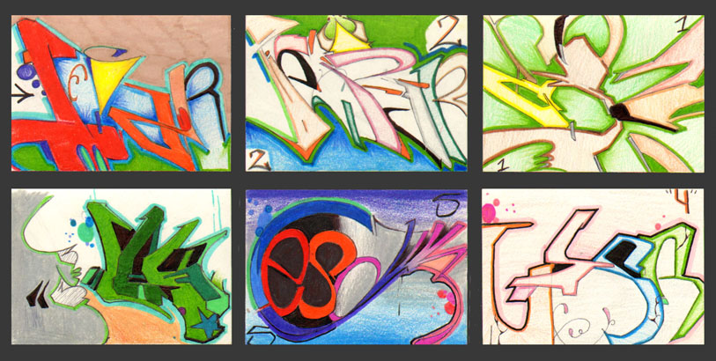
Notes:
Great again.. Its all his name… but why!!!! Did he number them!

Slide 14
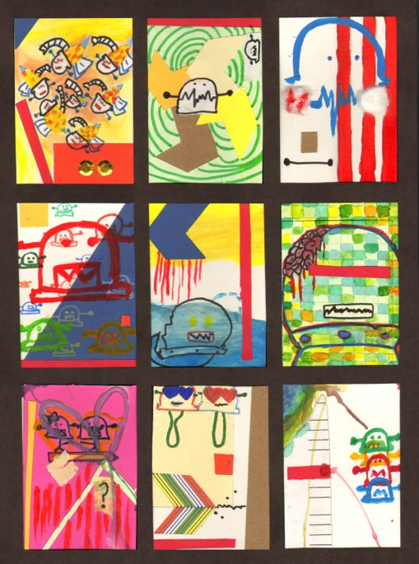
Notes:
The theme can be as simple as a character in different situations.

Slide 15
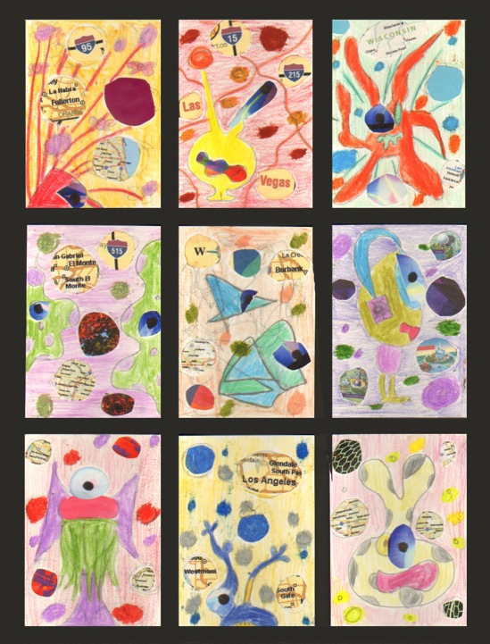

Slide 16
